Slide 1
“The Natural Language Inference Abilities of a Large Language Model.”
Kyle Urban
Capstone Mentor: Dr Zachary Stine, PhD
Second Reader: Dr Matteo Fiorini, PhD
Capstone Monitor: Dr Tina Huddleson, JD

Slide 2
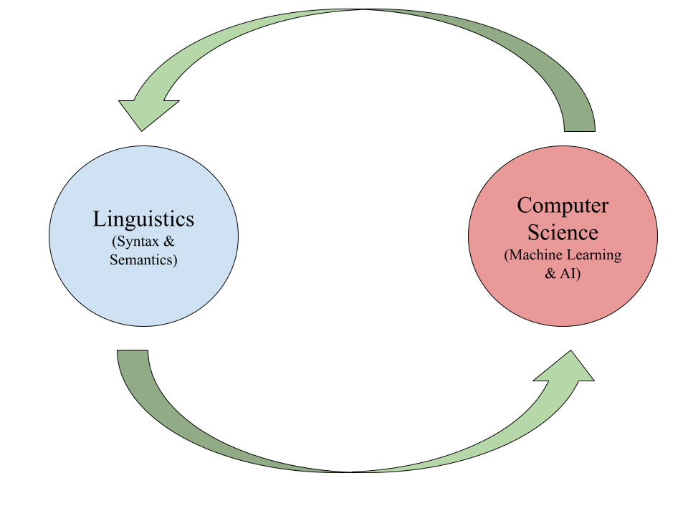
Overview
Central Question
BERT Model/LLMs
What is a Preposition?
Landmark & Trajectory
Logical Relationships
MutliNLI
(Set-up)
Experiment 1
Experiment 2
Discussion
Conclusion

Slide 3
Central Question
What influence do spatial prepositions have on the BERT LLM’s ability to encode logical relationships between sentences?

Slide 4



BERT Model & LLMs
Large Language Model (LLM)
Deep Learning → ANNs

Slide 5


BERT Model & LLMs
(BERT)
Bidirectional Encoder Representations from Transformers
12 layers of neurons
(Delvin, et al. 2018)

Slide 6
What is a preposition?
Any guesses?

Slide 7
Landmark & Trajectory (L&T)
Spatial Relations
Landmark — the reference point
Trajectory — motion in space
Ex: “St Paul’s Cathedral is over the bridge”
Landmark = [bridge]
Trajectory = [over]
Ex: “The cat hid in the closet”
Landmark = [closet]
Trajectory = [in]
(Evans. & Green, pg 334-339, 2006)

Slide 8
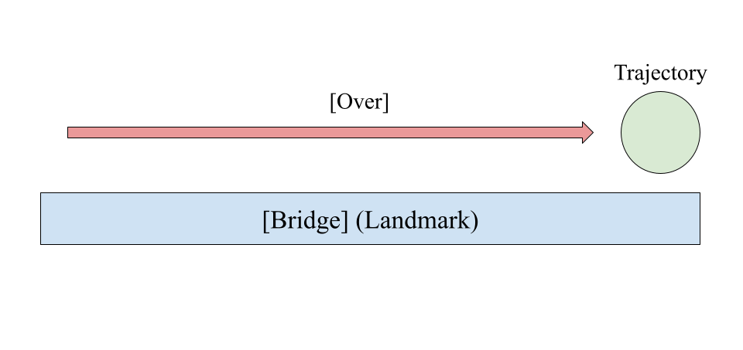
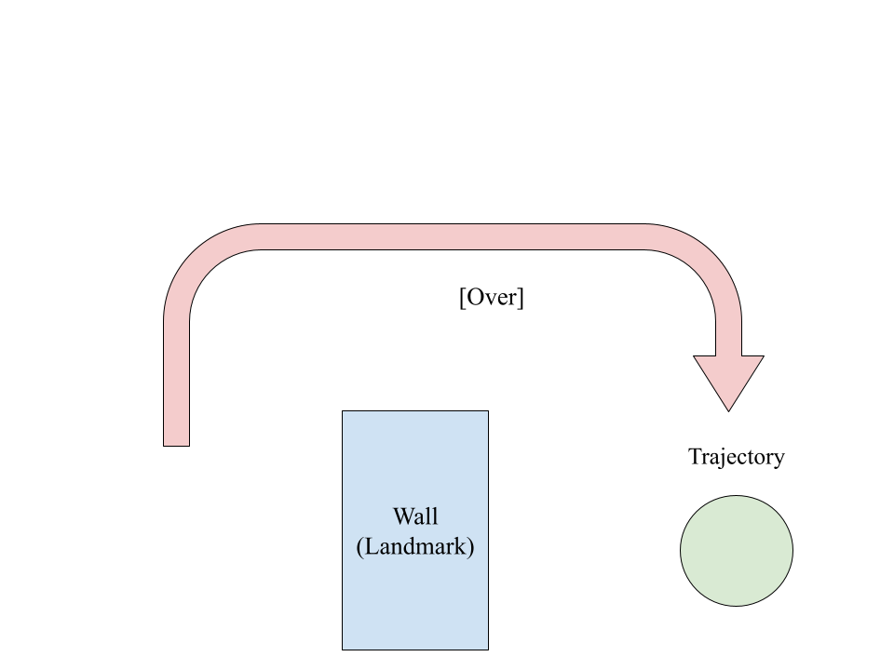
Landmark & Trajectory (L&T)
Spatial Relations often embedded in prepositions
Can have multiple meanings or metaphorical extension
Ex: “he walked over a bridge” v.s “the bird flew over a wall”

Slide 9
Okay… but why does L&T matter?

Slide 10
Entailment!
(and its friends)

Slide 11
Logical Relationships (3 principle types)
Entailment
Sentence A → Sentence B
If A is true, B is true
Ex: The emperor was assassinated → The emperor is dead
Contradiction
Sentence A ⋀¬ Sentence B
If A is true, B is false
Ex: My car was stolen ⋀¬ My car is in my possession
Neutrality
Sentence A ≁ Sentence B
No relation between A & B
Ex: The lemons are spoiled ≁ The child goes to school
(Saeed, I. John, pp 94-97, 2016)

Slide 12
Logical Relationships — can you guess them?

Slide 13
Example 1:
Sentence A:
A profile crowns Chris Rock The Funniest Man in America.
Sentence B:
Chris Rock has been crowned The Funniest Man in America.

Slide 14
Answer: Entailment
Sentence A:
A profile crowns Chris Rock The Funniest Man in America.
Sentence B:
Chris Rock has been crowned The Funniest Man in America.

Slide 15
Example 2:
Sentence A:
One thing was worrying me dreadfully, but my heart gave a great throb of relief when I saw my ulster lying carelessly over the back of a chair.
Sentence B:
I was dreadfully worried about many things.

Slide 16
Answer: Contradiction
Sentence A:
One thing was worrying me dreadfully, but my heart gave a great throb of relief when I saw my ulster lying carelessly over the back of a chair.
Sentence B:
I was dreadfully worried about many things.

Slide 17
Example 3:
Sentence A: …and the wind started blowing and it was one of my earlier trips to be really out in the middle of…
Sentence B: I was scared and wanted to go home.

Slide 18
Answer: Neutral
Sentence A: …and the wind started blowing and it was one of my earlier trips to be really out in the middle of…
Sentence B: I was scared and wanted to go home.

Slide 19
MultiNLI Corpus
433K sets of sentence pairs w/logical relation
Premise, Hypothesis, Gold Label
Train/test models
10K subset
~33% ratio between labels

Slide 20
But most importantly….
The MultiNLI is rich with Spatial Prepositions

Slide 21
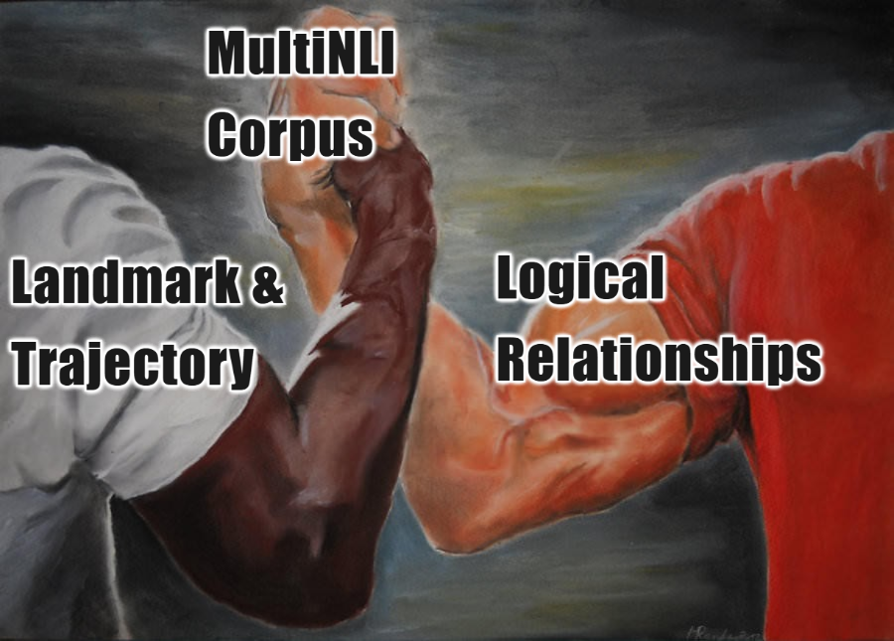

Slide 22
Meet the Prepositions
Spatial Prepositions integral to context
in, out, over, under, above, below, inside, outside, around, behind, on, through, throughout, near, beneath, into, beside, off, between, next, upon, from, on top, in front, next to.
~4.5K usage instances in MultiNLI

Slide 23
Set-Up
MultiNLI subset
Only instances where P has spatial prepositions
Two instances, one having (control) & one lacking (variable)

Slide 24
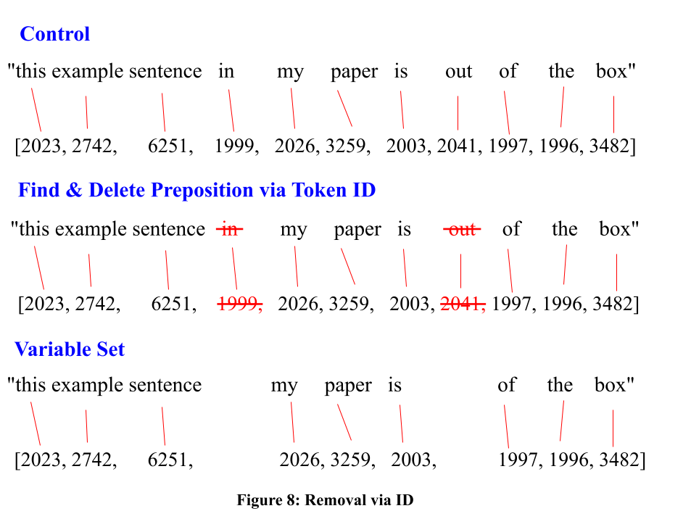
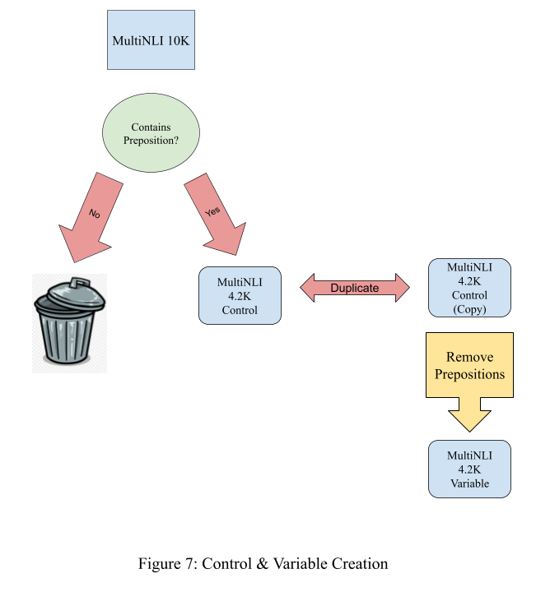
Control/Variable Creation (Set-up)

Slide 25
Visualize.
You are the model.

Slide 26
Example 1 (Modified):
Sentence A*: Neither does it include the mail sent response to advertising.
Sentence B: The mail sent in response to advertising is included .
Can you guess? Is it Entailment, Contradiction, or Neutral?

Slide 27
Example 1 (Unmodified):
Sentence A: Neither does it include the mail sent in response to advertising.
Sentence B: The mail sent in response to advertising is included .
How about now?

Slide 28
Answer: Contradiction

Slide 29
Example 2 (Modified):
Sentence A*: Then he gave
Sentence B: He gave in

Slide 30
Example 2 (Unmodified):
Sentence A: Then he gave in
Sentence B: He gave in

Slide 31
Answer: Entailment

Slide 32
Example 3 (Modified):
Sentence A*: “Oh, i i haven't quite worked that.”
Sentence B: I am still processing the whole thing.

Slide 33
Example 3 (Unmodified):
Sentence A: “Oh, I I haven't quite worked that out.”
Sentence B: I am still processing the whole thing.

Slide 34
Answer: Entailment

Slide 35
Was it easy?
What happened in your head?

Slide 36


Experiment 1
“Lobotomy Approach”
BERT embeds language via mathematical representation
Classification Model trains and tests off BERT’s mathematical representations
Indicative?

Slide 37
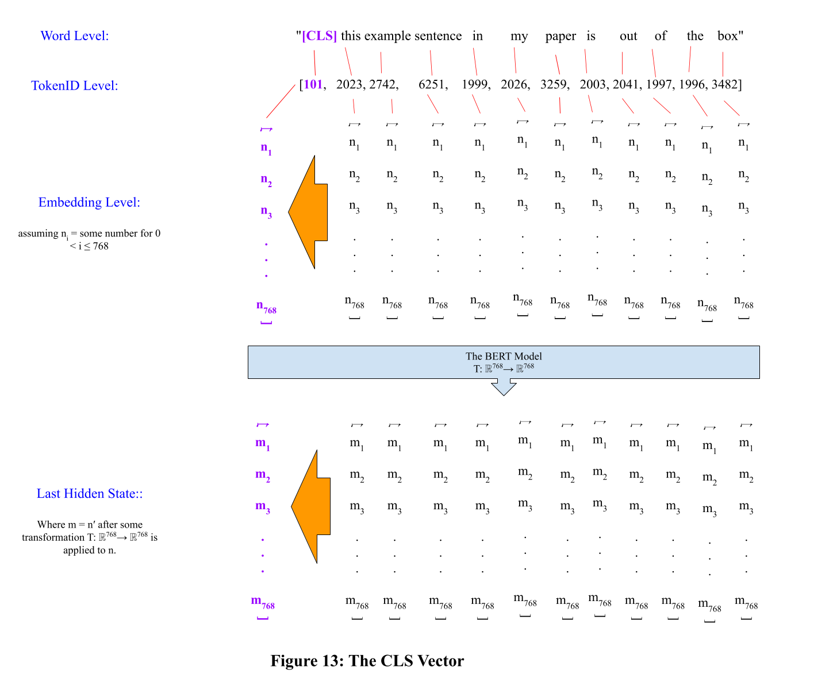
How BERT encodes (Exp 1)

Slide 38
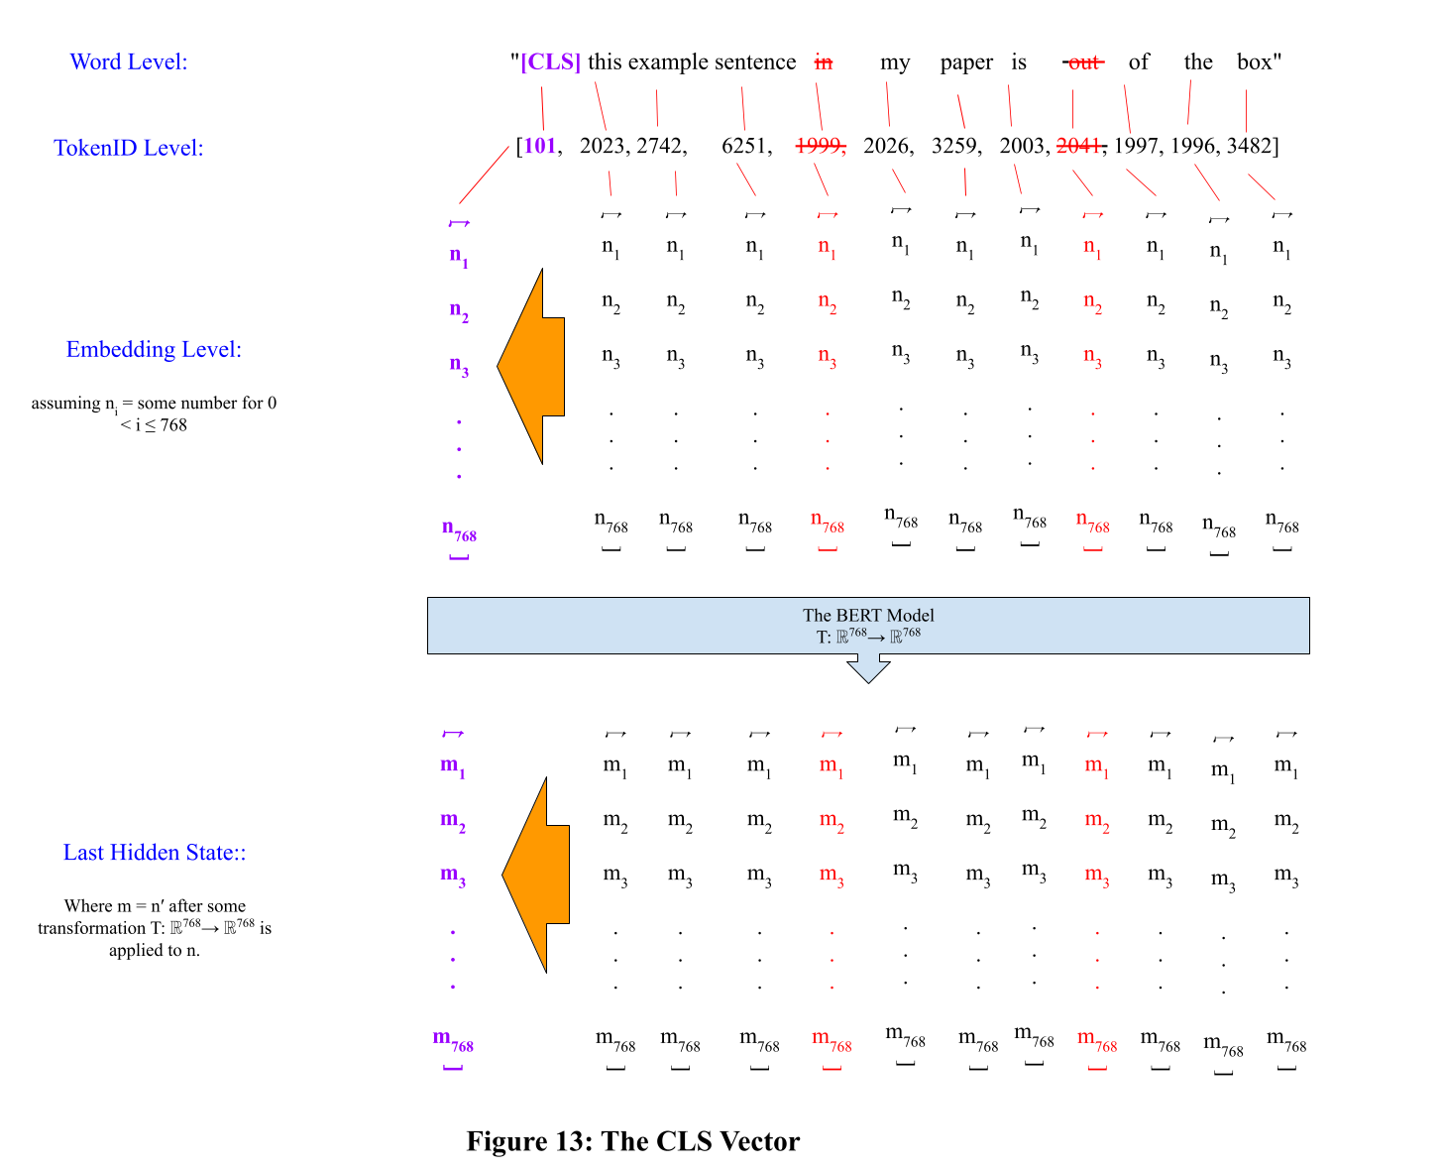
How BERT encodes (Exp 1)

Slide 39
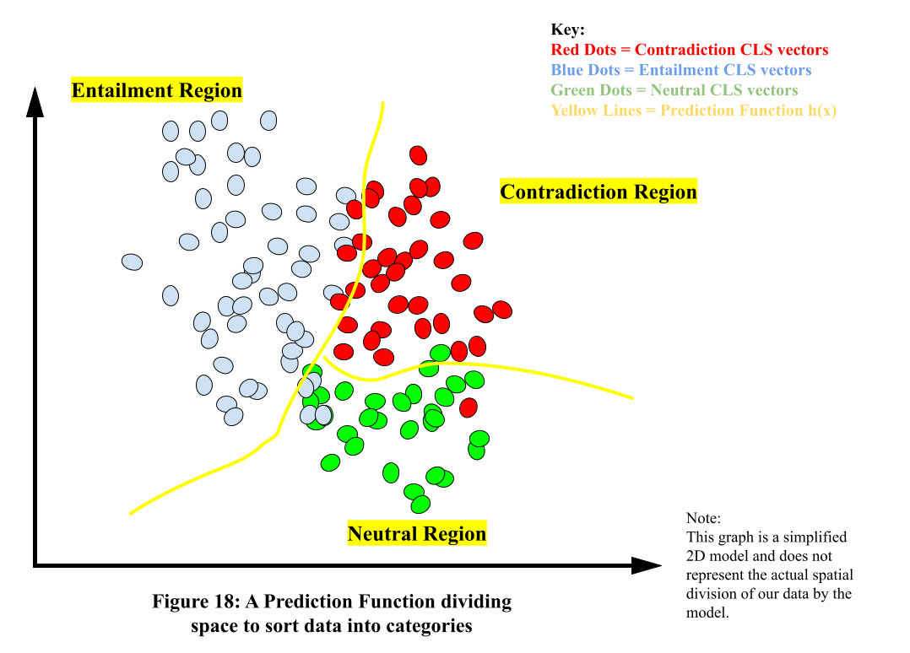
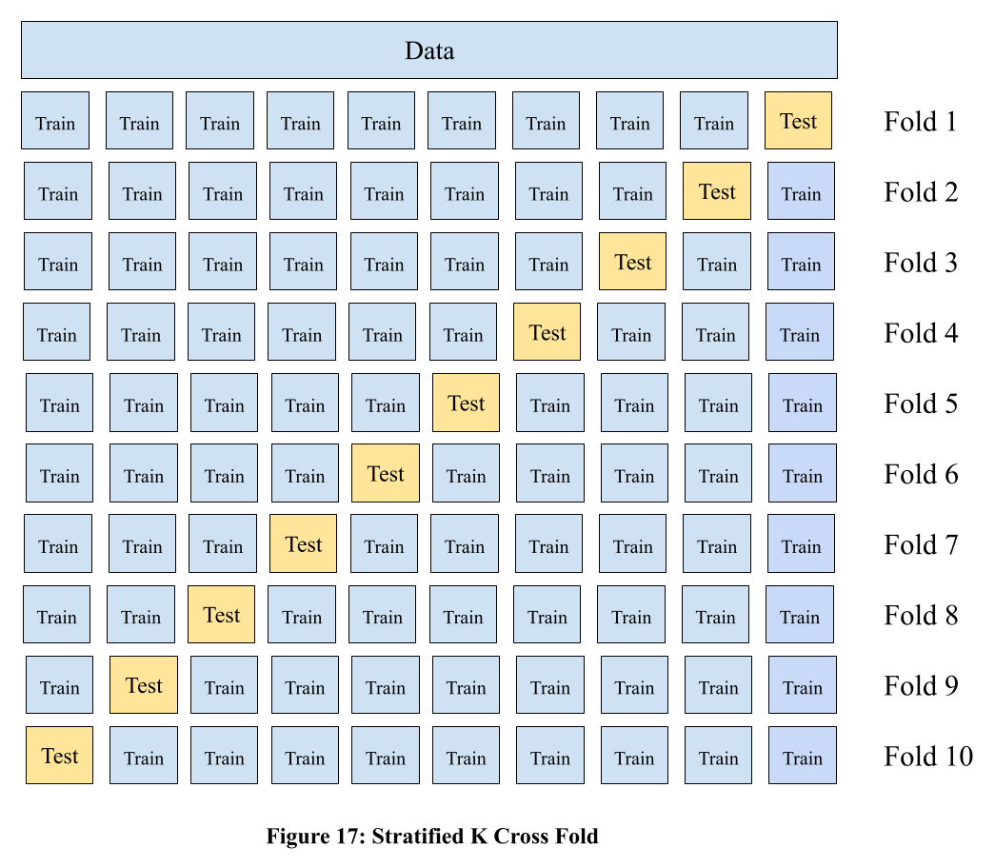
Classification Model Innerworkings (Exp 1)
“Feed BERT’s brains to classification model”

Slide 40
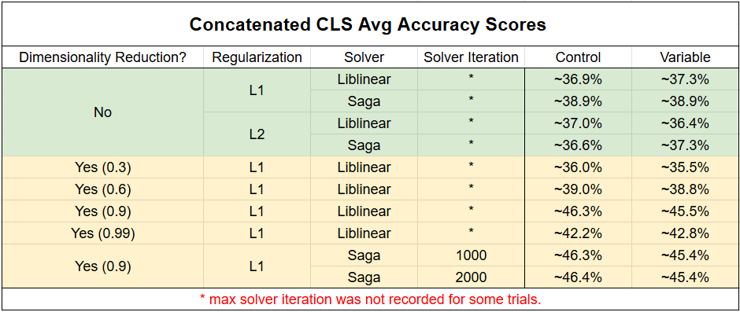
Experiment 1
No better than random guessing

Slide 41
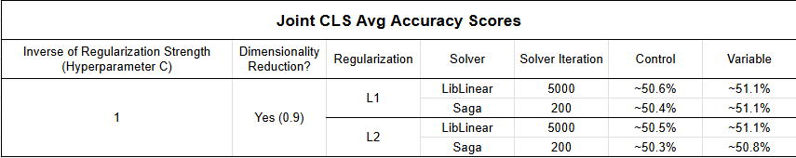
Experiment 1
Attempted Improvements
Dimensionality Reduction (Principal Component Analysis) Ax = λx
Hyperparameter Search
Mean Pooling & Joint Embeddings
Random Forest Classifier v.s Stratified K Cross Fold

Slide 42

Experiment 1
Highest CLF Model performance was around 49%~50%
Minimal dissimilarity in performance between control & variable
Underfitting data
Pattern but we just can’t see it.

Slide 43

Experiment 2
“Classroom Approach”
Fine-tune BERT itself on control dataset subset
Test BERT on holdout subsets of control & variable.
Performance comparable between sets

Slide 44
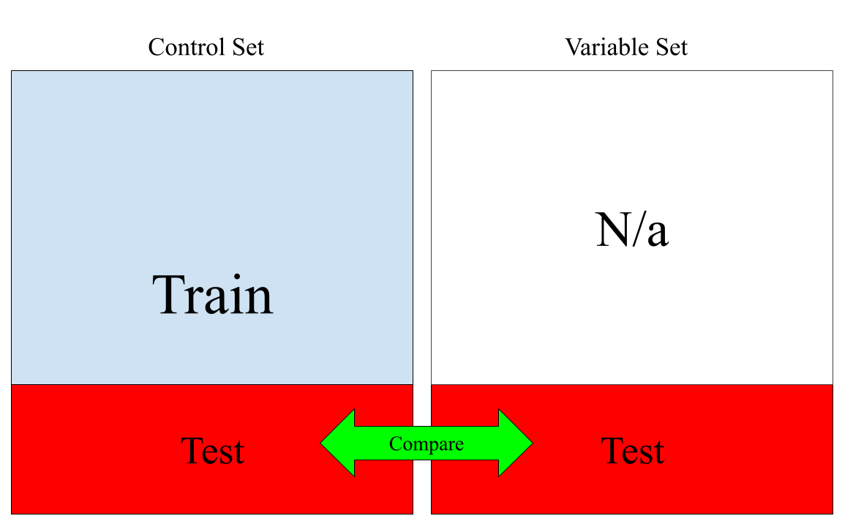
Test/Train per trial diagram (Exp 2)

Slide 45

Discussion
From Experiment 2:
Control: 69.3%
Variable: 68.4%
Not a significant difference in performance.
Linguistic Implications?
Diminished roll of prepositions.
Conclusive?

Slide 46

Limitations
Constraints
Time
Lack of regularization strategy for experiment 2
AdamW
Lack of Data
Full 433k dataset
Different Model?
RoBERTa, SBERT*

Slide 47
Conclusion
Spatial Prepositions did not demonstrate a significant influence on BERT’s encoding of logical relations between sentences
Though, additional follow up is needed due to limitations.

Slide 48
Sources
Bowman, R. Samuel, et al. “A Broad-Coverage Challenge Corpus for Sentence Understanding through Inference” ArXiv. 19 Feb, 2018. https://doi.org/10.48550/arXiv.1704.05426
Conneau, Alexis, et al. “Supervised Learning of Universal Sentence Representations from
Natural Language Inference Data” ArXiv. 8 Jul, 2018. https://arxiv.org/pdf/1705.02364
Delvin, Jacob, et al. “BERT: Pre-training of Deep Bidirectional Transformers for Language Understanding” ArXiv. 11 Oct, 2018. https://doi.org/10.48550/arXiv.1810.04805
Evans, Vyvyan. & Green, Melanie. “Cognitive Linguistics: An Introduction.” LAWRENCE ERLBAUM ASSOCIATES. 2006. pg 334-339
Saeed, I. John. “Semantics” WILEY Blackwell. 4th ed. 2016. pp 94-97.

Slide 49
Appendix

Slide 50
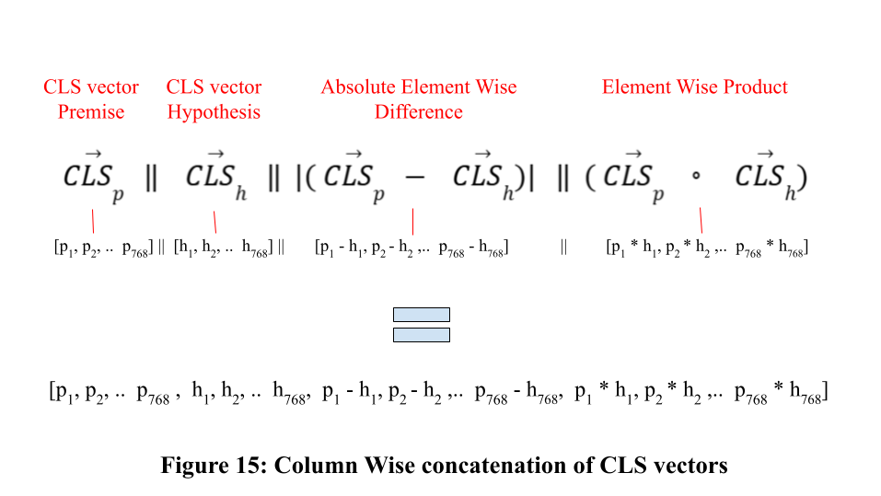
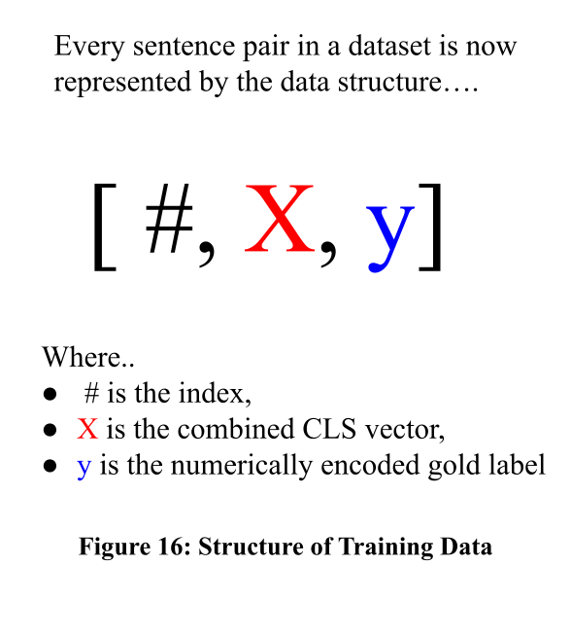
Informative CLS vectors (Exp 1)
(Conneau, et al. 2018)

Slide 51
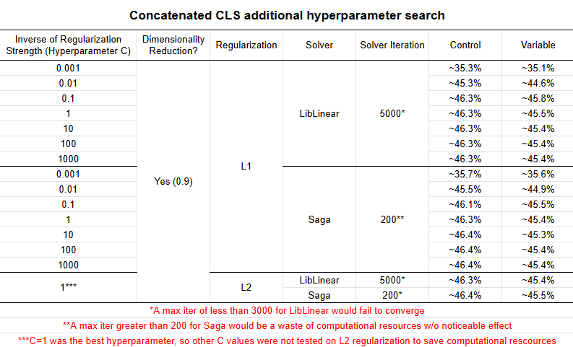
Hyperparameter Search (Exp 1)

Slide 52
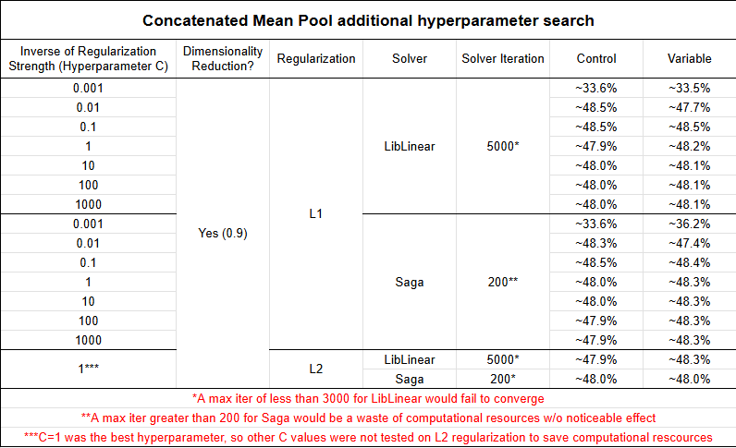
Mean Pool, Joint Mean Pool, Random Forest (Exp 1)

Slide 53
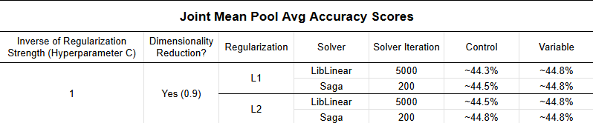
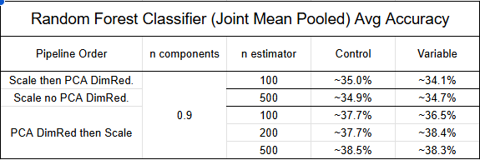
Mean Pool, Joint Mean Pool, Random Forest (Exp 1)

Slide 54
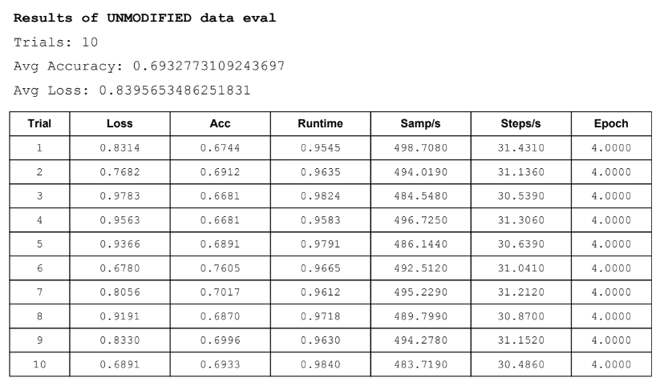
Experiment 2 (Control Results)

Slide 55
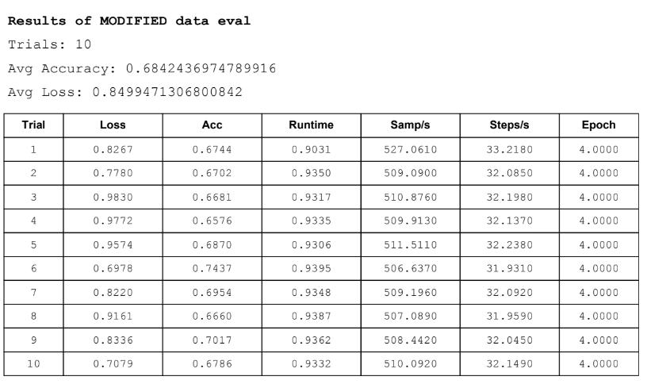
Experiment 2 (Variable Results)

